Slide 1

Meet the Teacher
September 2026
Chestnut Class

Slide 2
Teachers
Mrs Hopkinson-Jones (Monday-Tuesday)
(Wednesday – Friday)
Mrs Robinson Wed

Slide 3
Welcome to Chestnut and well done to all of the children who have settled well. Your child’s well-being is of utmost importance to us. Please use the email address
chestnut@nestonpri.cheshire.sch.uk
If you have any queries or questions and we will endeavour to respond asap.

Slide 4
The Expectations for Chestnut
There is an expected level in Reading, Writing and Maths, that children should reach by the end of Year 3 and by the end of Year 4.
However, some children might be working towards the expected level and some children might exceed the expected level.

Slide 5

Reading
We are using Accelerated Reader this year. Children will be bringing home a book at the appropriate level.
As well as encouraging a love of reading, we will also be developing retrieval and inference skills.
We check the Accelerated Reader progress chart throughout the week, so they must be reading every day.
Each half term your child has an individualised target.
Some children will be given extra reading tasks which we will speak to parents individually about.

Slide 6

Current Topics
Maths- Place Value
Addition & Subtraction
English- Coming to England
Handwriting
Sentence Construction
Vocabulary
History - Romans
Science – Y3 and 4 – Animals including Humans
RE – Judaism
Computing- Computing Systems and networks
PE- Swimming – Wednesday Invasion and basketball - Friday
Art- Drawing self-portraits & exploring tone, texture and proportion
Spanish - greetings

Slide 7
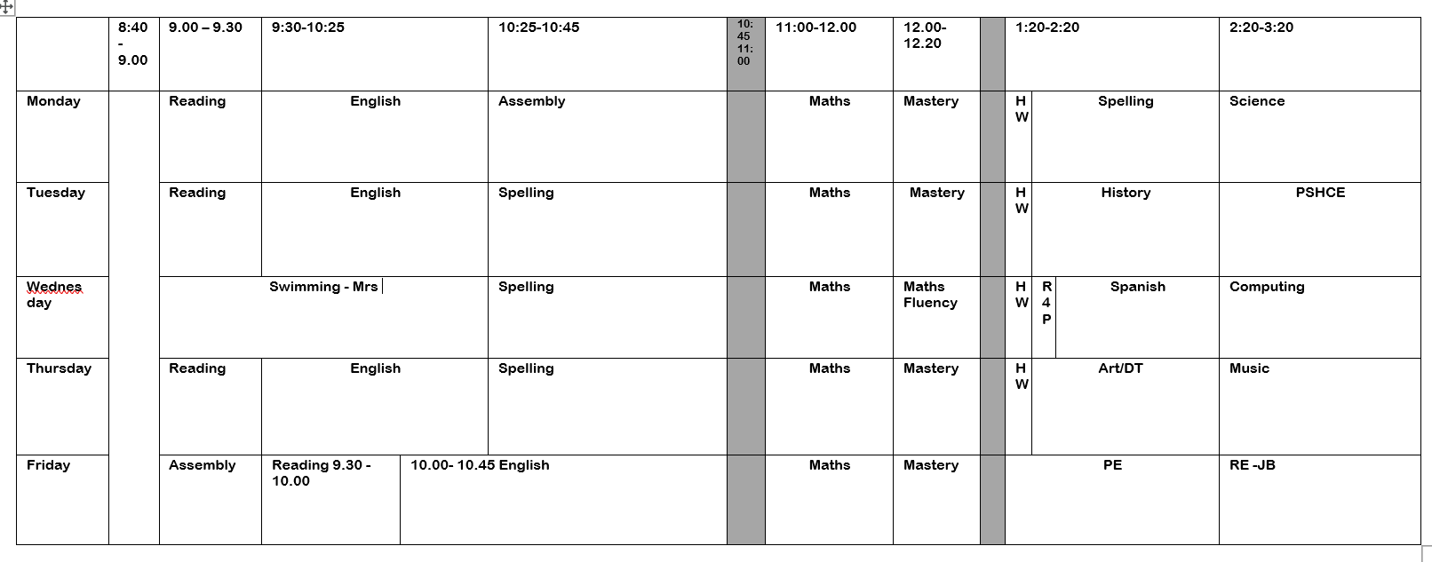

Slide 8
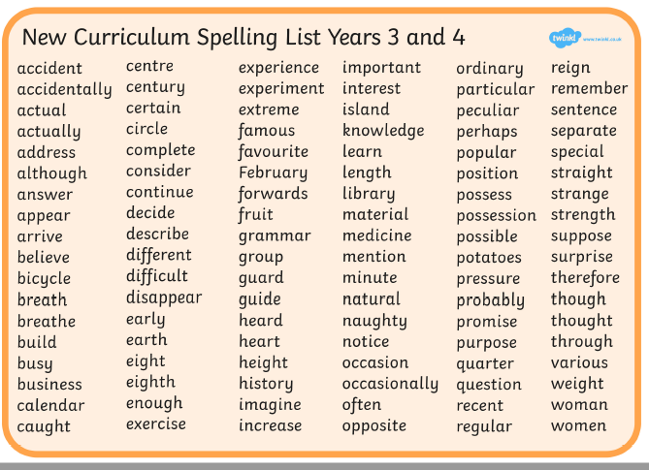

Slide 9
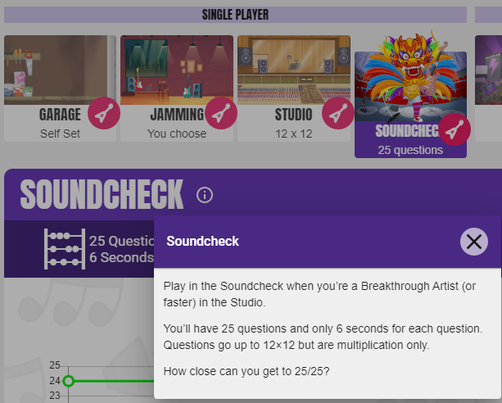
Maths Y4
Times table check – National test – just like the phonics test in Y1. It is an online assessment.
There are 25 questions – they have 6 seconds to answer each question.
The Soundcheck game on TT Rockstars is the ideal way to practise for it.
They need to be on this for 3 minutes every day. This will result in a fluency of 4 seconds a fact, which correlates with getting 25/25 on the MTC check.

Slide 10
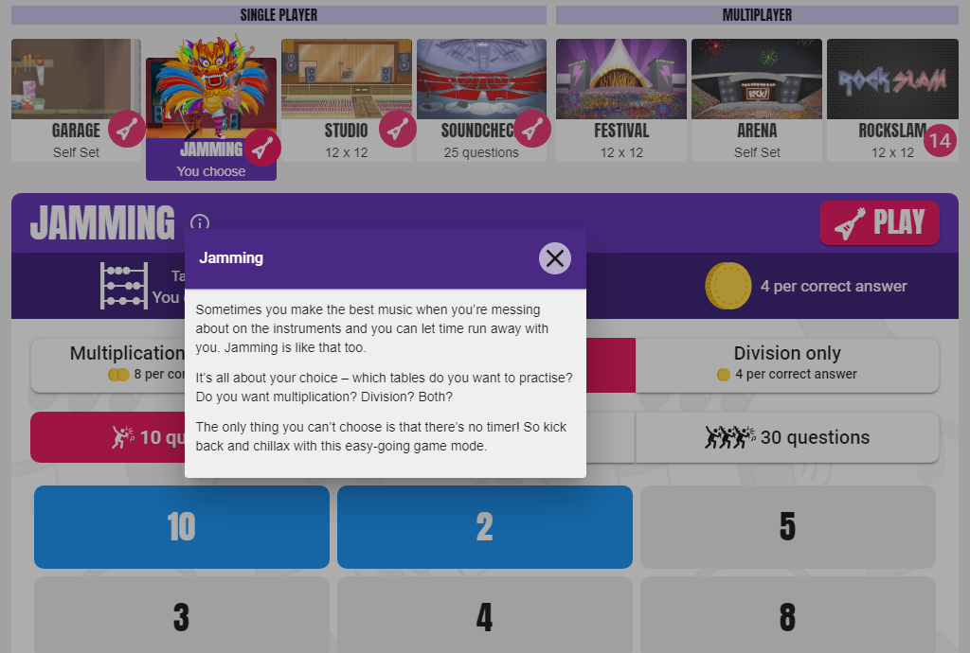

Slide 11
Different Game Modes in TTRS
Jamming- no timer and get to pick the times tables they want to practise
Studio – 10 games and will give them their rock speed. The aim is to go from a 'wannabe' to a 'rock hero/rock legend'
Soundcheck- set out the same as the MTC check (year 4s will be doing this every day in school but practising at home too will help)

Slide 12
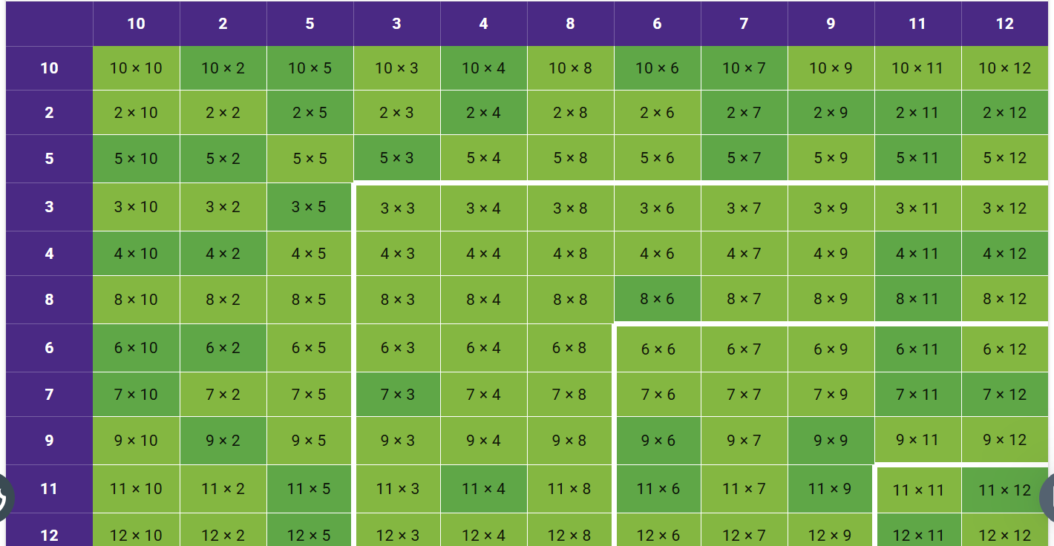

Slide 13
Heat map
Every game (except Jamming as this is not timed) will impact on your child's heatmap.
You can view your child's heat map by clicking on their avatar (top left corner) and then clicking 'My Stats'.
The aim is to for their heatmap to go completely green – this means they have consistently answered each multiplication fact within 4 seconds or less. They must answer each fact at least 10 times in any game mode (apart from Jamming) at 4 seconds or less before it will turn green on their heatmap.

Slide 14
Homework
Reading- daily – Accelerated reader – see individual letters for your child’s log in details.
Century – One English Task One Maths Task each week – Set Monday
Maths – Times Table Rockstars log in details to be sent home on Relaunch Day- your child needs to be on it 3 minutes every day.
Spellings – 10 words a week from the Year 3/4 spelling list – to be tested the following Monday.

Slide 15
Other information for Willow Class
Please bring a coat and a water bottle every day.
You may want to provide your child with a piece of fruit for snack. Only fruit is allowed for snack.
PE Days- Friday - Mr B
Wednesday - Swimming
Please put your child’s name in all clothing items.
Meal Selection- Please try to do this at home even if your child is a packed lunch every day.

Slide 16
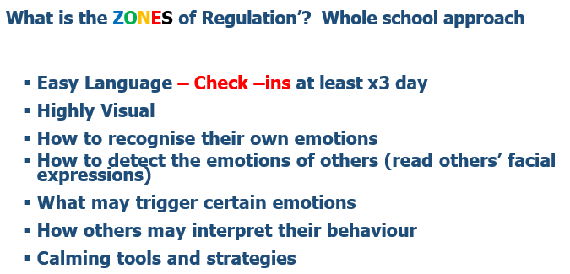

Slide 17
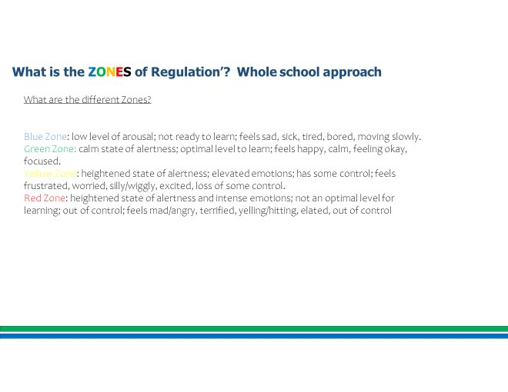

Slide 18


Slide 19
Exciting Events!
Swimming- Every Wednesday in the Autumn Term
TTRS Relaunch Day – Dress up as a Rockstar- Monday 14th September

Slide 20
Exciting Events!
Hummingbird Mental Health Programme
KS2 Trip to Chester - Romans
Tuesday 22nd September

Slide 21
Exciting Events!
Class Rewards and individual Reward Charts
Library visit
Christmas Carol Service

Slide 22
Other information
Please bring a coat and a water bottle every day.
You may want to provide your child with a piece of fruit for snack. Only fruit is allowed for snack.
PE Days- Wednesday - Swimming and Friday
Please put your child’s name in all clothing items.
Meal Selection- Please to do this at home even if your child is a packed lunch every day.

Slide 23
Any Questions?

