Slide 1

Meet the Teacher
September 2026
Maple Class

Slide 2
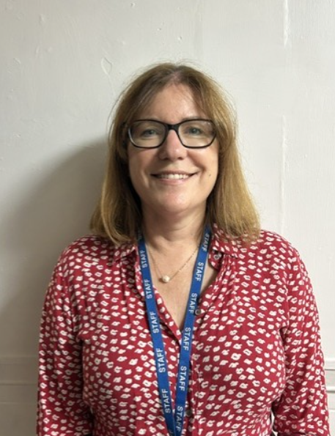
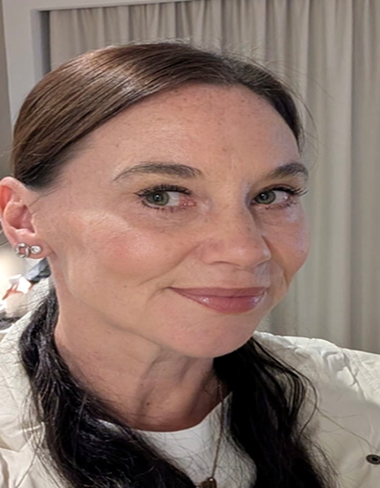
Meet the Team
Ms Thompson
Reception and Year 1 teacher
Monday – Wednesday
Deputy Head and SENCO – Friday
Literacy Lead
Mrs Bravo
Reception and Year 1 teacher
Thursday and Friday
PPA cover – Mrs Robinson and Mr Burrows

Slide 3
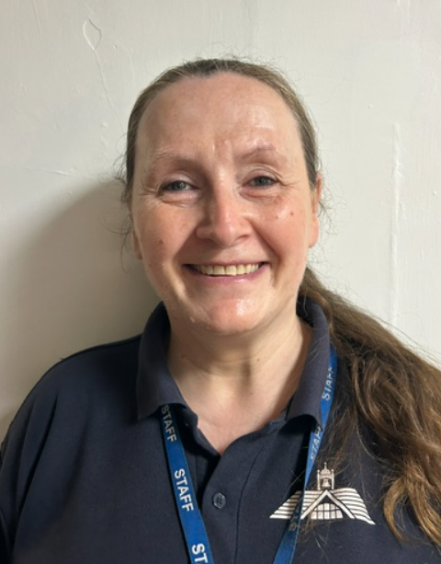
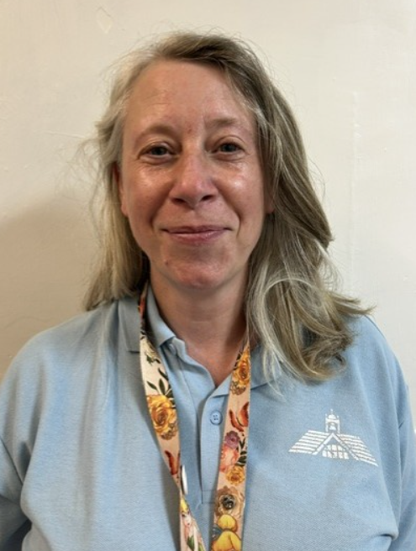
Mrs Walley – support staff
Mrs Wallaston – support staff

Slide 4

Your child’s well-being is of utmost importance to us. Please use the email address
maple@nestonpri.cheshire.sch.uk
If you have any queries or questions and we will endeavour to respond asap.

Slide 5
Curriculum
Reception The EYFS curriculum
In EYFS we use a holistic, play based approach with a careful balance of child-initiated and adult learning. Learning is based upon the Prime areas of learning which support the children in the Specific areas of learning.
Year 1 is a very important year as the children transition from the Early Years Curriculum to the National Curriculum.
We will support the children with this transition during the Autumn term.

Slide 6
Assessments
Reception - Baseline assessments within the first
6 weeks of school – government measure of
future progress
Year 1 - Phonic Check - June 2026

Slide 7
Typical day in reception and Year 1
8:40 Line up on the playground and walk into school together
9:00 Phonics and reading
9:40 Literacy workshop – range of adult led and independent
activities inside and outside
10:30 Fruit and drink
10:45 Playtime
11:00 Maths workshop - range of adult led and independent
activities inside and outside
12:20 Lunchtime
1:20 Range of afternoon activities – cover all areas of
learning - range of adult and independent activities inside and outside
2:50 Story time
3:20 End of school day

Slide 8

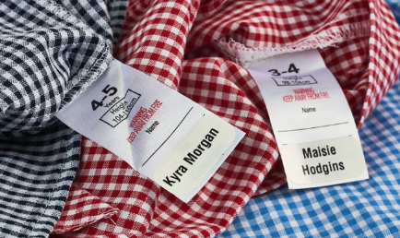
Please bring a coat and a water bottle every day.
You may want to provide your child with a piece of fruit for snack. Only fruit is allowed for snack.
PE Days- Tuesday and Thursday – come dressed in PE kit
Please put your child’s name in all clothing items.
Meal Selection- Please try to do this at home even if your child is a packed lunch.

Slide 9
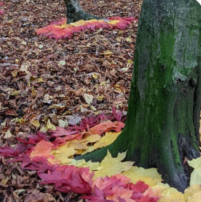
Forest School – Welly Wednesday Afternoon
Please make sure your child comes to school in a long sleeve t-shirt, long trousers, coats and wellies for this session.

Slide 10



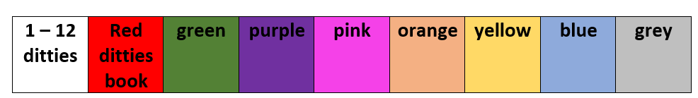
Reading
Book levels
Expectation by
end of Year 1

Slide 11


Books Home
The children will bring home :
A RWI book that they have read in class that week. They should be confident reading this book and will be able to practise fluency and their ‘reader voice’.
Two ‘love of reading book’ that they choose and you read to them.

Slide 12
Writing: Drawing Club
Drawing Club is a creative teaching approach used in early childhood and primary classrooms (like Reception and Year 1) to help children fall in love with stories, build their vocabulary, and spark early writing.
Drawing Club is built on the 3M principle: Making conversation, Mark making (drawing and early writing), and Mathematics. During ‘Drawing children enter an "imagined world" based on picture books, fairy tales and classic animations.

Slide 13

Writing:
At NPS all classes follow a scheme, called Pathways to Write. There is a unit per half term based around a high quality picture book.
The initial focus will be:
children orally rehearsing a sentence before writing, which we call ‘hold a sentence’.
Children applying their phonic skills to their spelling.
Writing sentences with capital letters and full stops
Handwriting
As the year progresses the Year 1children will use ‘and’ to join sentences.

Slide 14
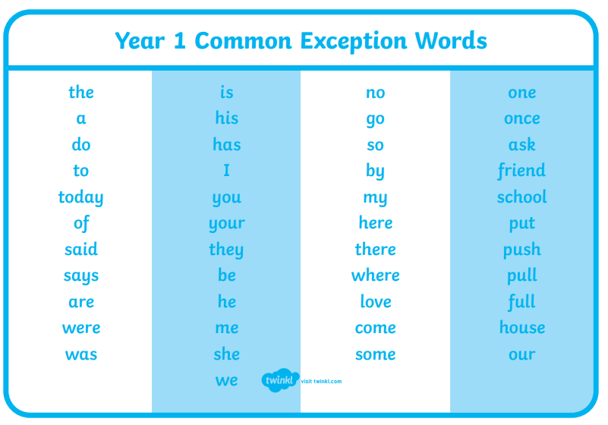
Spelling

Slide 15
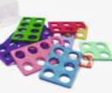
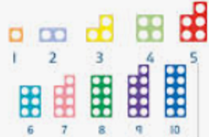
Maths (First for Maths)
At NPS we follow a Mastery approach in Maths to develop fluency and a deep understanding of concepts.
During the daily maths lessons children use manipulatives to understand mathematical structures. This enables them to progress to using pictures and jottings before being able to solve abstract problems.
4 and 3 =

Slide 16

Maths - Reception
Counting: Say numbers in order up to 20. Touch and count objects accurately.
Subitising: Spot how many items are in a small group (up to five) without counting them one by one.
Number Bonds: Learn pairs of numbers that add up to 5 or 10 (like 2 and 3 making 5).
More and Less: Compare groups of items to see which has more or less

Slide 17
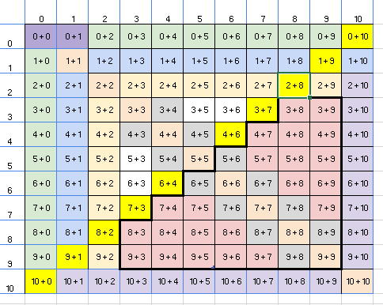
Maths
To secure the Year 1 objectives children need to practise:
Counting to 100 forwards and backwards starting at any number.
Reading and writing numbers up to 100 ( teen and ty numbers)
Counting in 2s (starting at 0 and 1), 5s, 10s
Number bonds to 10
All the ways to make 5,6,7,8,9,10

Slide 18

Maths
‘A little and often’
Numbots-log in details were sent home on Monday.
At home go to play.numbots.com (download app)
It is an online maths learning platform that helps children learn how to add and subtract, improving their fluency and recall in basic mental maths.
Start in Story Mode to develop understanding and once secure they can start visiting Challenge Mode to improve fluency.

Slide 19
Dates for the Diary
Numbots Day – Monday 14th September
PFA Sponsored Walk – Tuesday 6th October
Parents Evening - Tuesday 20th October and Thursday 22nd October
Cyber Safety – Monday 7th December
Reception and KS1 Nativity – Tuesday 15th December

Slide 20
Any Questions?

