Slide 1

Meet the Teacher
September 2026
Sycamore Class

Slide 2
Teachers
Miss Ebbrell (Monday-Friday)
In Class Support: Mrs Pino, Mrs Bailey, Mrs Furlong

Slide 3
Welcome to Sycamore and well done to all of the children who have settled well. Your child’s well-being is of utmost importance to us. Please use the email address
sycamore@nestonpri.cheshire.sch.uk
If you have any queries or questions and we will endeavour to respond asap.

Slide 4
The Expectations for Sycamore
There is an expected level in Reading, Writing and Maths, that children should reach by the end of Year 6.
However, some children might be working towards the expected level and some children might exceed the expected level.

Slide 5

Reading
We are using Accelerated Reader this year. Children will be bringing home a book at the appropriate level.
As well as encouraging a love of reading, we will also be developing retrieval and inference skills.
We check the Accelerated Reader progress chart throughout the week, so they must be reading every day.
Each half term your child has an individualised target.

Slide 6

Current Topics
Maths- Place Value
English- Star of Fear, Star of Hope- linked to World War Two
History - Romans
Science – Living things: classifying big and small
RE – Why does religion look different around the world?
Computing- Computing Systems and Networks
PE- With Mr B (Netball and Basketball)
PE with Miss E- Outdoor Activities
Art- Drawing self-portraits
Depth, emotion and movement

Slide 7
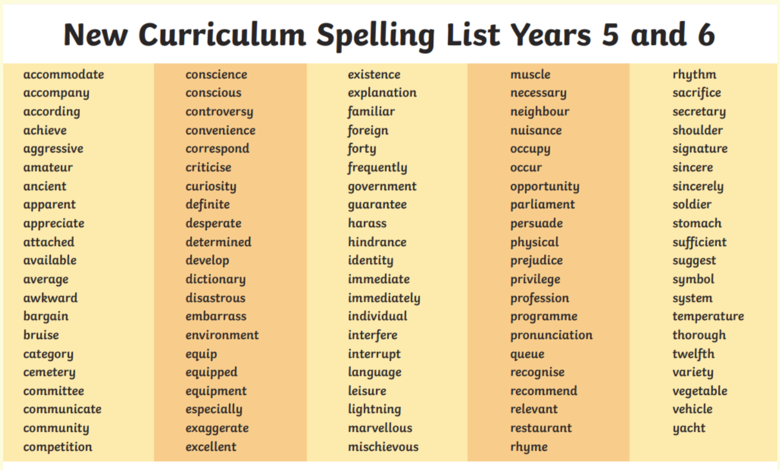

Slide 8
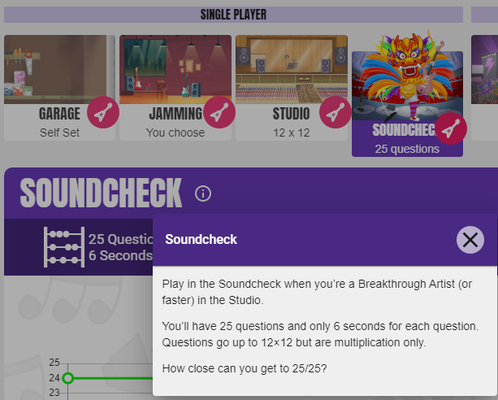
Maths
The Soundcheck game on TTRockstars is the ideal way to practise for it.
They need to be on this for 3 minutes every day.

Slide 9
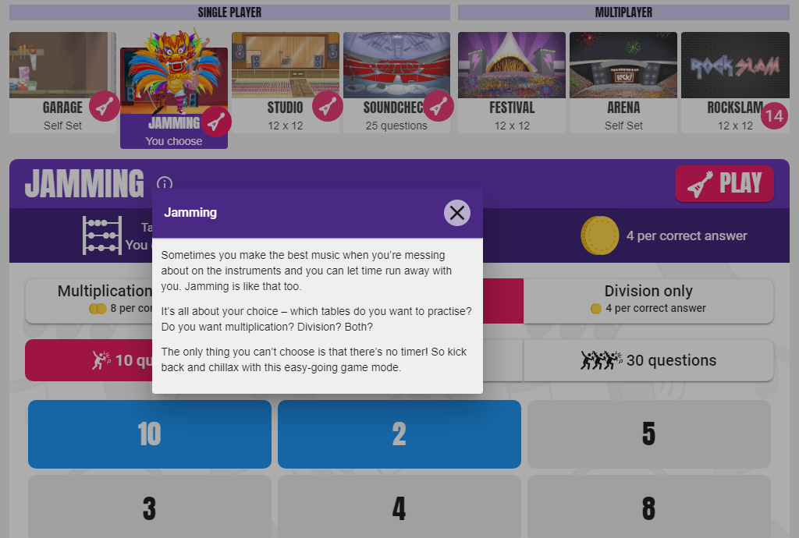

Slide 10
Different Game Modes in TTRS
Jamming- no timer and get to pick the times tables they want to practise
Studio – 10 games and will give them their rock speed. The aim is to go from a 'wannabe' to a 'rock hero/rock legend'
Soundcheck- set out the same as the MTC check

Slide 11
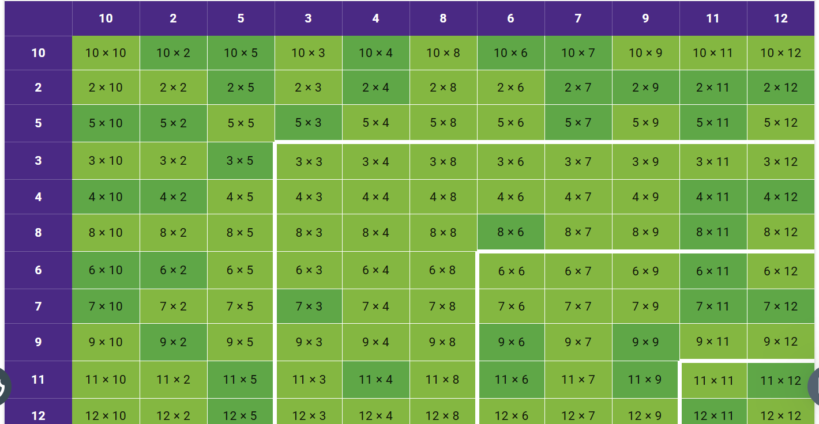

Slide 12
Heat map
Every game (except Jamming as this is not timed) will impact on your child's heatmap.
You can view your child's heat map by clicking on their avatar (top left corner) and then clicking 'My Stats'.
The aim is to for their heatmap to go completely green – this means they have consistently answered each multiplication fact within 4 seconds or less. They must answer each fact at least 10 times in any game mode (apart from Jamming) at 4 seconds or less before it will turn green on their heatmap.

Slide 13
Homework
Reading Daily – Accelerated reader – see individual letters for your child’s log in details.
Maths – Times Table Rockstars log in details to be sent home on Relaunch Day- your child needs to be on it 3 minutes every day.
Century – one English and one Maths Homework each week.
Arithmetic Work to begin with (Send home on a Monday and bring in the following Monday)
Spellings each week from the Y5/6 word list- to be tested the following Monday.

Slide 14
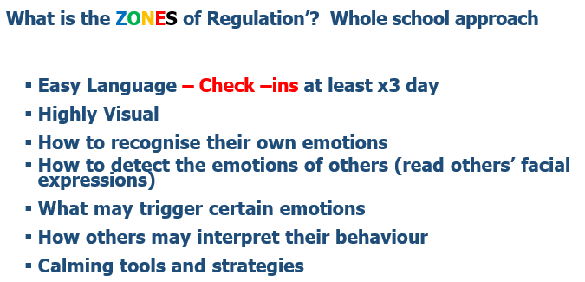

Slide 15
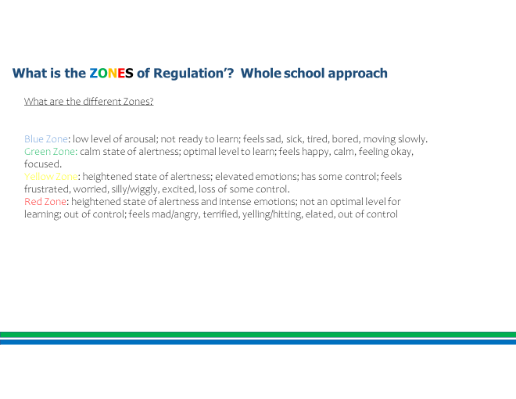

Slide 16


Slide 17
Other information for Sycamore Class
Please bring a coat and a water bottle every day.
You may want to provide your child with a piece of fruit for snack. Only fruit is allowed for snack.
PE Days- Monday & Wednesday (may change in the spring term but you will be notified)
Please put your child’s name in all clothing items.
Meal Selection- Please try to do this at home even if your child is a packed lunch every day.

Slide 18
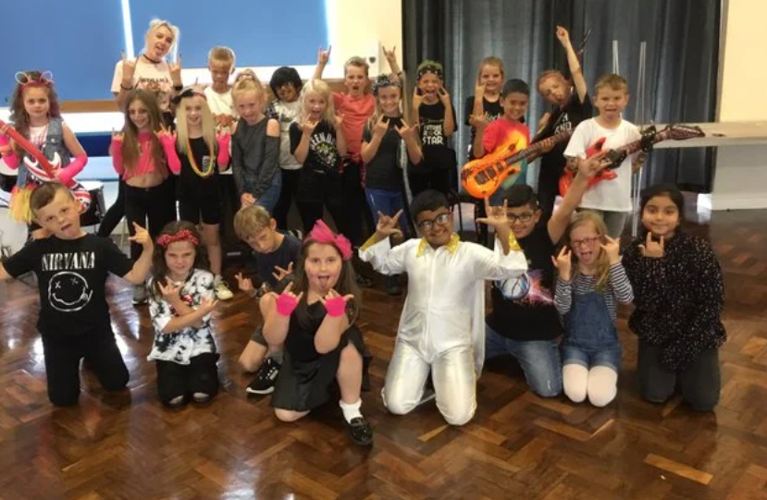

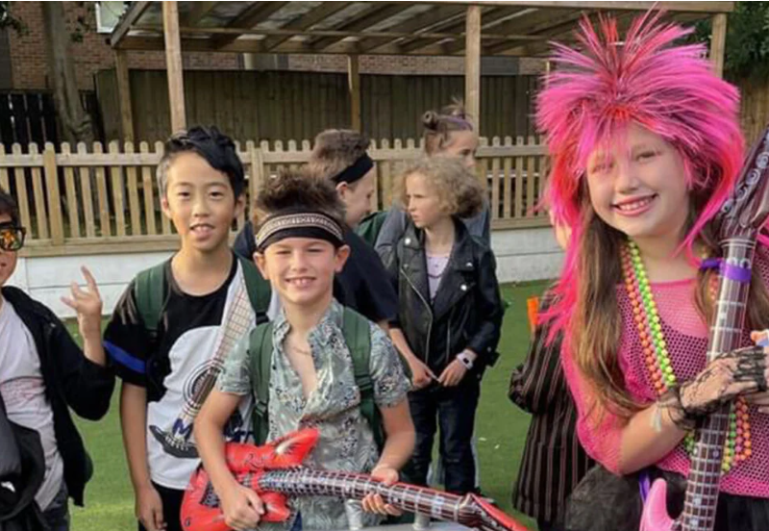
Rockstar Day
Monday 14th September
Please don’t feel like you need to go out and buy anything.

Slide 19
Other Dates for Diary
Tuesday 22nd September- Trip to Chester for the Romans
Hummingbird Project – Mental Health Programme starting on Fridays
Conway Trip – Wednesday 10th March- Friday 12th March
We will be swimming in the Spring Term- further details will follow
SATs Week – Monday 10th May- Thursday 13th May

Slide 20
Home/ School Contract
Please read with your child/ children now and sign.

Slide 21
Walking Home
You must give written permission to the office if you want your child to walk home from school.
If your child is walking home and you would like them to bring a phone into school, they must switch them off and hand them in on the way into school. They will be handed them back at the end of the day.

Slide 22
Any Questions?

