Slide 1

Meet the Teacher
September 2026
Willow Class

Slide 2
Teachers
Mrs Smith (Monday - Friday)
Mrs Elliott and Mr B (Wednesday afternoon)
Mr Burrows (Friday morning)
Mrs Collins (Monday - Friday)
Miss Lewis (Monday - Friday)

Slide 3
Welcome to Willow. I am thrilled to be your childs teacher. I am looking forward to a year filled with learning, growth and memorable experiences.
Your child’s well-being is of utmost importance to us. Please use the email address
willow@nestonpri.cheshire.sch.uk
If you have any queries or questions and we will endeavour to respond asap.

Slide 4
The Expectations for Willow
There is an expected level in Reading, Writing and Maths, that children should reach by the end of Year 4 and by the end of Year 5.
However, some children might be working towards the expected level and some children might exceed the expected level.

Slide 5

Reading
We are using Accelerated Reader this year. Children will be bringing home a book at the appropriate level.
As well as encouraging a love of reading, we will also be developing retrieval and inference skills.
We check the Accelerated Reader progress chart throughout the week, so they must be reading every day.
Each half term your child has an individualised target.

Slide 6

Current Topics
Maths- Place Value
Science - Materials, Mixtures and Seperation
Art -Self Portraits Banksy, Da Vinci, Diego Rivera
English- Queen of the falls.
Goodnight stories for rebel girls.
RE – Why are the five pillars of Islam important to Muslims?
Music - Future yard
History - Why did the Romans invade Britain?
PE with Mr B and Mr B

Slide 7
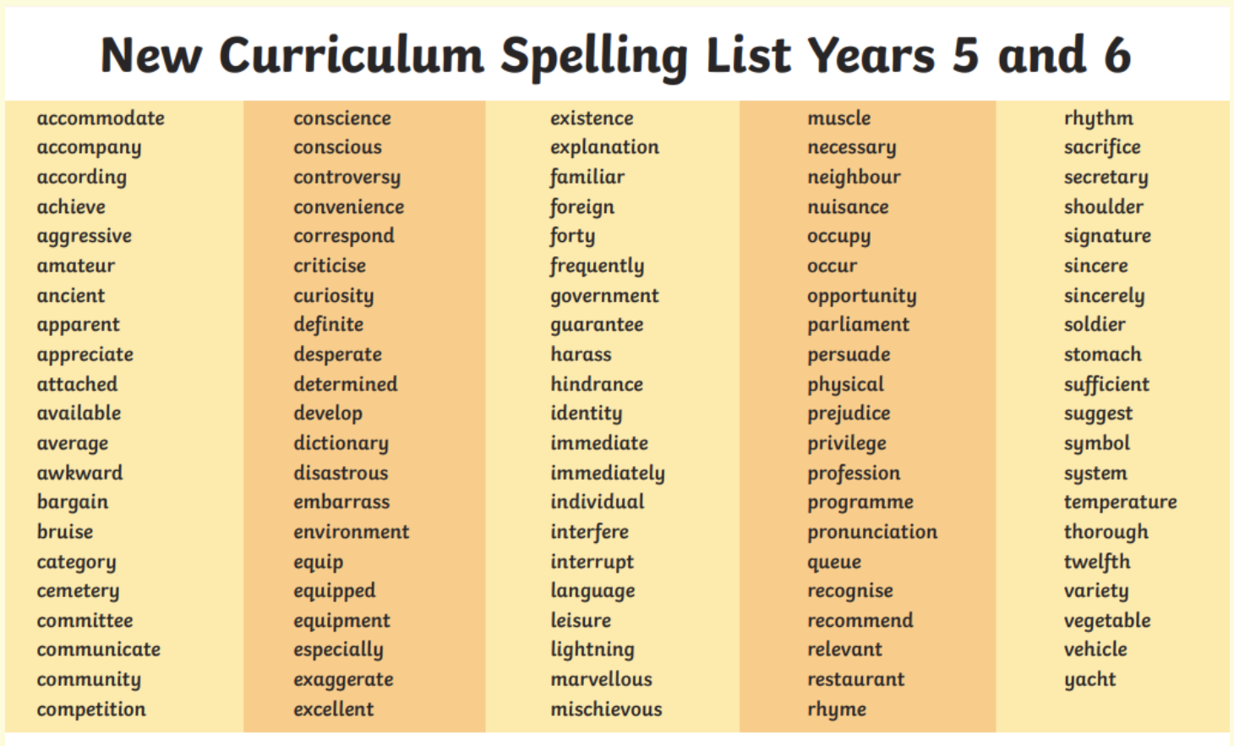

Slide 8
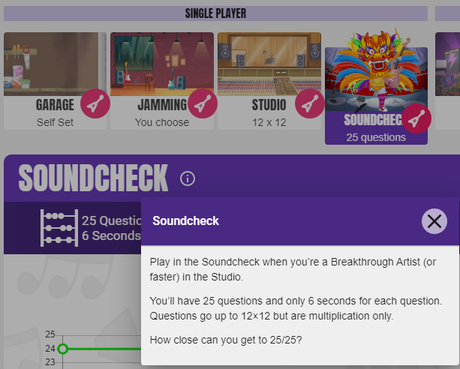
Maths Y5
The Soundcheck game on TTRockstars is the ideal way to practise for it.
They need to be on this for 3 minutes every day.

Slide 9
Different Game Modes in TTRS
Jamming- no timer and get to pick the times tables they want to practise
Studio – 10 games and will give them their rock speed. The aim is to go from a 'wannabe' to a 'rock hero/rock legend'
Soundcheck- set out the same as the MTC check (year 4s will be doing this every day in school but practising at home too will help)

Slide 10
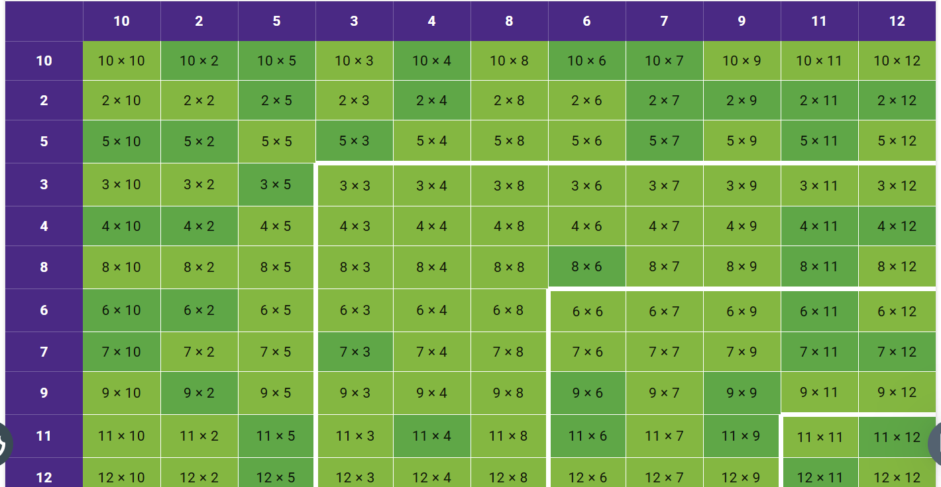

Slide 11
Heat map
Every game (except Jamming as this is not timed) will impact on your child's heatmap.
You can view your child's heat map by clicking on their avatar (top left corner) and then clicking 'My Stats'.
The aim is to for their heatmap to go completely green – this means they have consistently answered each multiplication fact within 4 seconds or less. They must answer each fact at least 10 times in any game mode (apart from Jamming) at 4 seconds or less before it will turn green on their heatmap.

Slide 12
Homework expectations
Daily expectations
Maths – Times Table Rockstars log in details to be sent home on Relaunch Day- your child needs to be on it 3 minutes every day.
Reading – Accelerated reader – see individual letters for your child’s log in details.
Weekly expectations
Century - One piece of English and one piece of Maths per week
Weekly spellings sent home on Mondays to be tested the following Monday

Slide 13
Other information for Willow Class
Please bring a coat and a water bottle every day.
You may want to provide your child with a piece of fruit for snack. Only fruit is allowed for snack.
PE Days- Wednesdays and Fridays
Please put your child’s name in all clothing items.
Meal Selection- Please try to do this at home even if your child is a packed lunch every day.

Slide 14
Other information for Willow Class
We require written permission to allow your child to walk home alone. Please email the office to give permission.
Only children who are walking home alone will be allowed to bring a mobile phone to school, they do not need to have a mobile phone to be able to walk home alone.
Any mobile phones will need to be handed in to staff before entering the building.

Slide 15
Swimming- Year 5 will be swimming in the summer term.
Further details to follow!
TTRS Relaunch Day – Dress up as a Rockstar- Monday 14th September

Slide 16
Any Questions?

