Slide 1


Meet the Teacher
September 2026
Year 2
Oak Class

Slide 2
Introduction
Welcome back and welcome to our new Year 2 classroom. Well done to all the children for settling in so well to our new routines. This year we will be known as Oak Class.
oak@nestonpri.cheshire.sch.uk

Slide 3
Year 2 is a very important year, when we consolidate the more formal learning from the end of Year 1 and prepare the children for moving to KS2.
The mornings will consist of the daily reading, writing, spelling and maths lessons.
In the afternoons we will cover the National Curriculum expectations for all the other subjects (Foundation Subjects).
Over the year, the children will be taught: Science, Geography, History, Computing, Art, DT, Music and PE.
Statutory RE and PHSE lessons will be taught through stories and discussions.

Slide 4
The Expectations for Year 2
There is an expected level in Reading, Writing and Maths, that children should reach by the end of Year 2
However, some children might be working towards the expected level and some children might exceed the expected level.

Slide 5
Maths
At NPS we follow a Mastery approach in Maths to develop fluency and a deep understanding of concepts.
During lessons children use manipulatives to understand mathematical structures. This enables them to progress to using pictures and jottings before being able to solve abstract problems
We are also on the KS1 Mastering Number Program so we have an extra fluency lesson for 10-15 minutes (4 days per week).

Slide 6
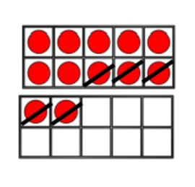
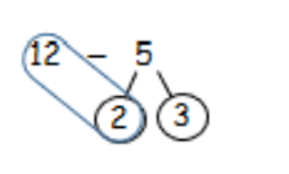
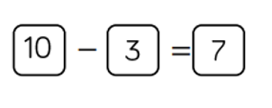

Slide 7
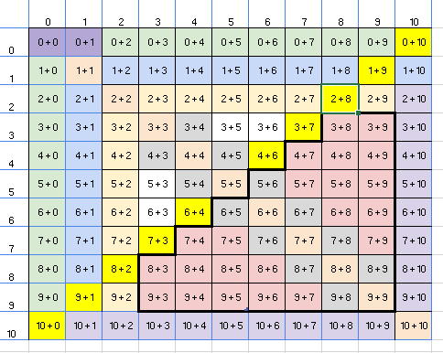
Maths - fluency
The children should be secure in these objectives as they left Year 1:
Counting to 100 forwards and backwards starting at any number.
Reading and writing numbers up to 100 ( teen and ty numbers)
Counting in 2s (starting at 0 and 1), 5s, 10s
Number bonds to 10

Slide 8
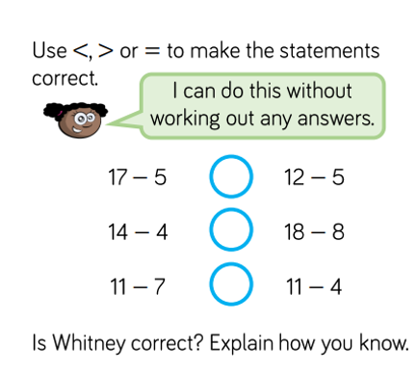
If children learn their number bonds, it frees up their working memory to be able to tackle problems and reasoning questions.
If I know 6 + 3 = 9
Then I know
9-6 = 3
9-3 = 6
60 + 30 = 90
26 + 3 = 29
etc

Slide 9
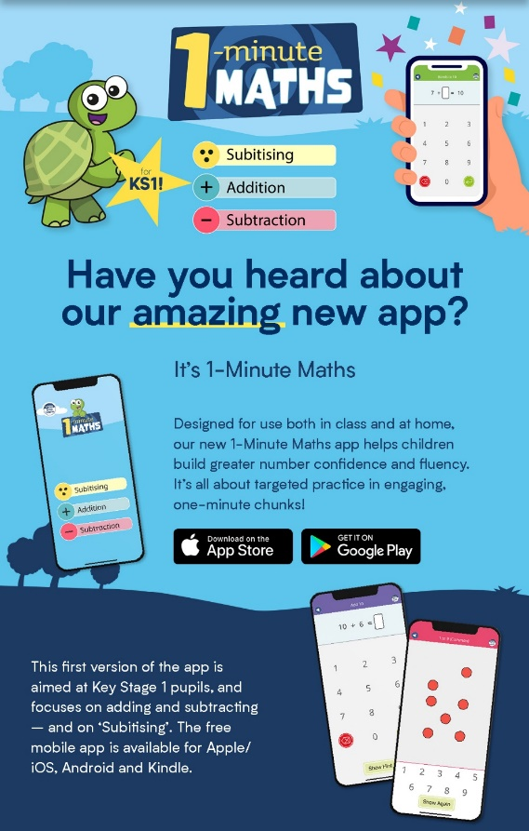
Please continue to play Numbots
Hit the Button - Quick fire maths practise for 6-11 year olds (topmarks.co.uk)

Slide 10
Reading
The Government guidelines state that children should learn to read through phonics. We use a programme called Read, Write, Inc.
The Year 2 children started the scheme from the beginning in their Reception year and will carry on until they exit the scheme (usually during Year 2).
Once children have exited the scheme they will bring home ‘colour banded’ reading books: Purple, Gold, White, Lime. Moving on to chapter books.
The children will explore spelling further using phonics and spelling rules.

Slide 11
Reading
Children will continue to have a daily reading lesson. Before they read the book, the children practise reading ‘red words’ (which are the tricky words) and ‘speedy green words’ (which the children should read speedily without sounding out)
As the children exit the scheme and become more fluent readers we will begin ‘Whole Class Reading’. This entails everyone having a copy of a more substantial book, which we read together to develop further fluency, expression and comprehension skills.

Slide 12
At NPS we want all children to have ‘a love of reading’, which is why the children will also bring home a book of their own choosing to share with you.
This book might be a picture book, non fiction or a novel.
Your child might be able to read all, some or none of it independently, but it’s a book for you to read with them so they are exposed to a wider range of books and vocabulary than you find in a ‘reading scheme book’.

Slide 13
Writing:
At NPS we follow the Pathways to Write scheme which is based on a high quality children’s book per half term.
The main focus this year is for children to write secure sentences that link their ideas.
The children will continue to use and to join sentences and begin to use other conjunctions such as because, but, when, if.
Children will begin to use adjectives in their work and begin to experiment with interesting vocabulary.
They will begin to use question marks, exclamation marks and apostrophes.

Slide 14
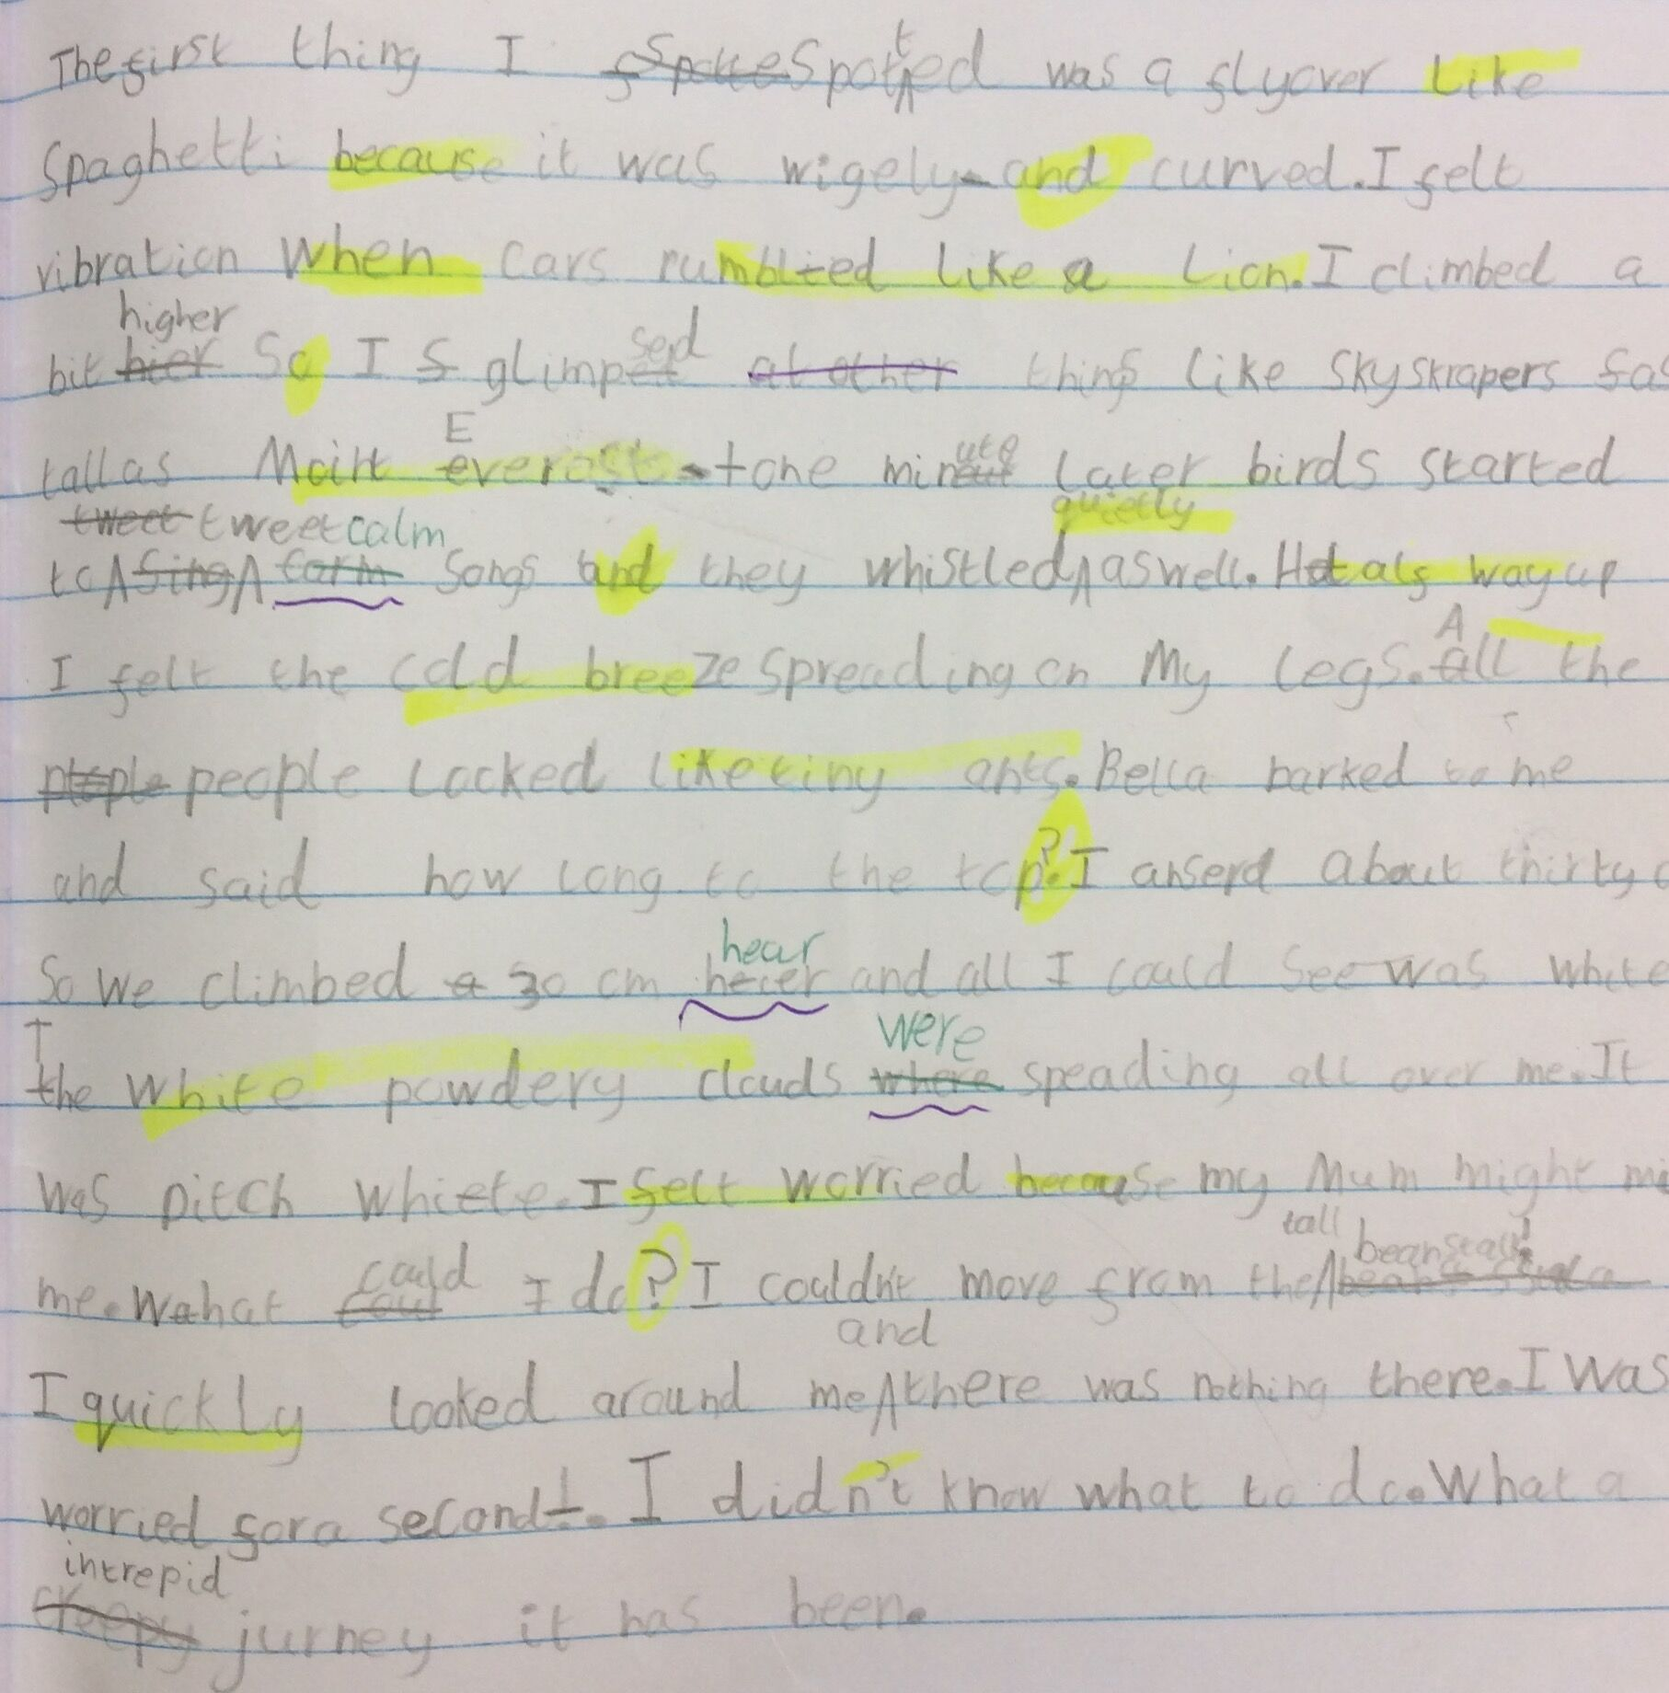
Stamina and quantity:
The children need to develop their stamina to write more, and for a more sustained amount of time.

Slide 15
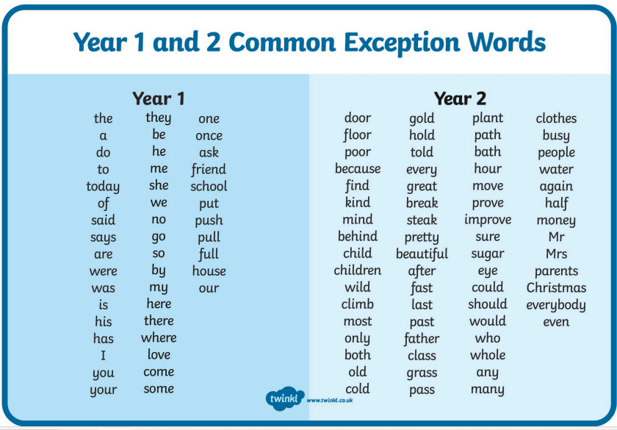
Spelling – ‘tricky’ words

Slide 16
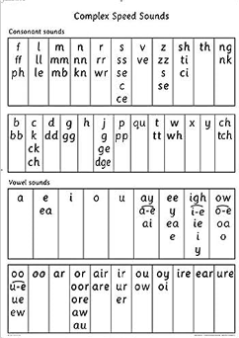
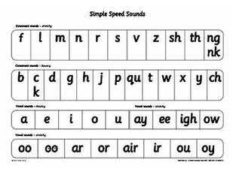
Spelling – Phonics based

Slide 17
Spelling – Year 2 spelling patterns/rules
Alternative
phonemes
Adding suffixes to words where a change is needed to the root word
hop – hopped
cry – cries
fun – funny
swim - swimming
Using apostrophes for contractions
did not – didn’t
I am – I’m
you are – you’re
And apostrophes for possession
The girl’s book.

Slide 18
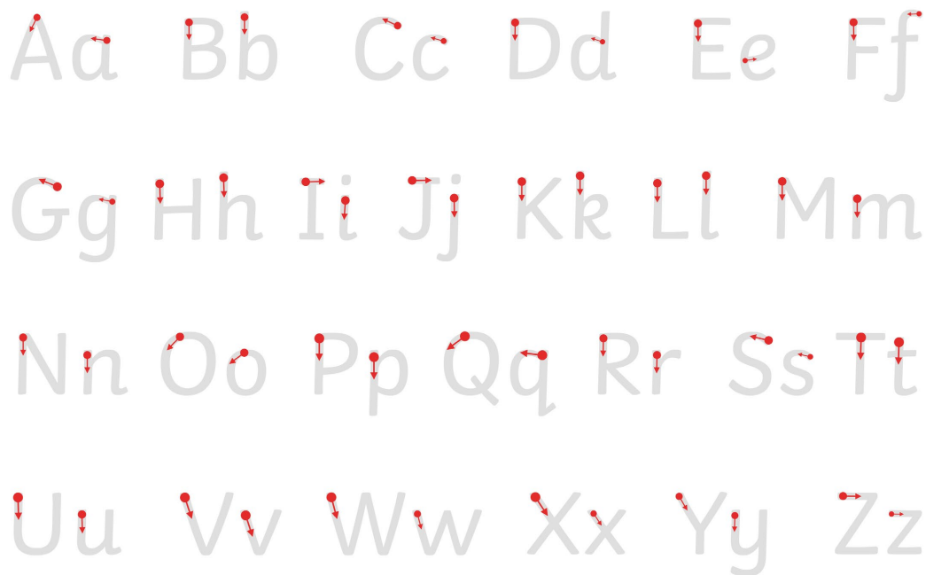
Handwriting
In Year 2 children will continue to practice formation of letters and learn some basic joins. There is a specific sequence to teaching these joins which will continue in KS2

Slide 19
Homework
‘A little and often’ is the best way for children to learn and practise the skills they need.

Slide 20
Homework
Reading – At least 3 times per week but 5 times is preferred (and daily is even better!)
Spellings- Year 1 & 2 tricky words
As time goes on: maths learn-its and later in the year – times tables.
Maths games eg. Numbots (if you need a reminder of password please ask)

Slide 21
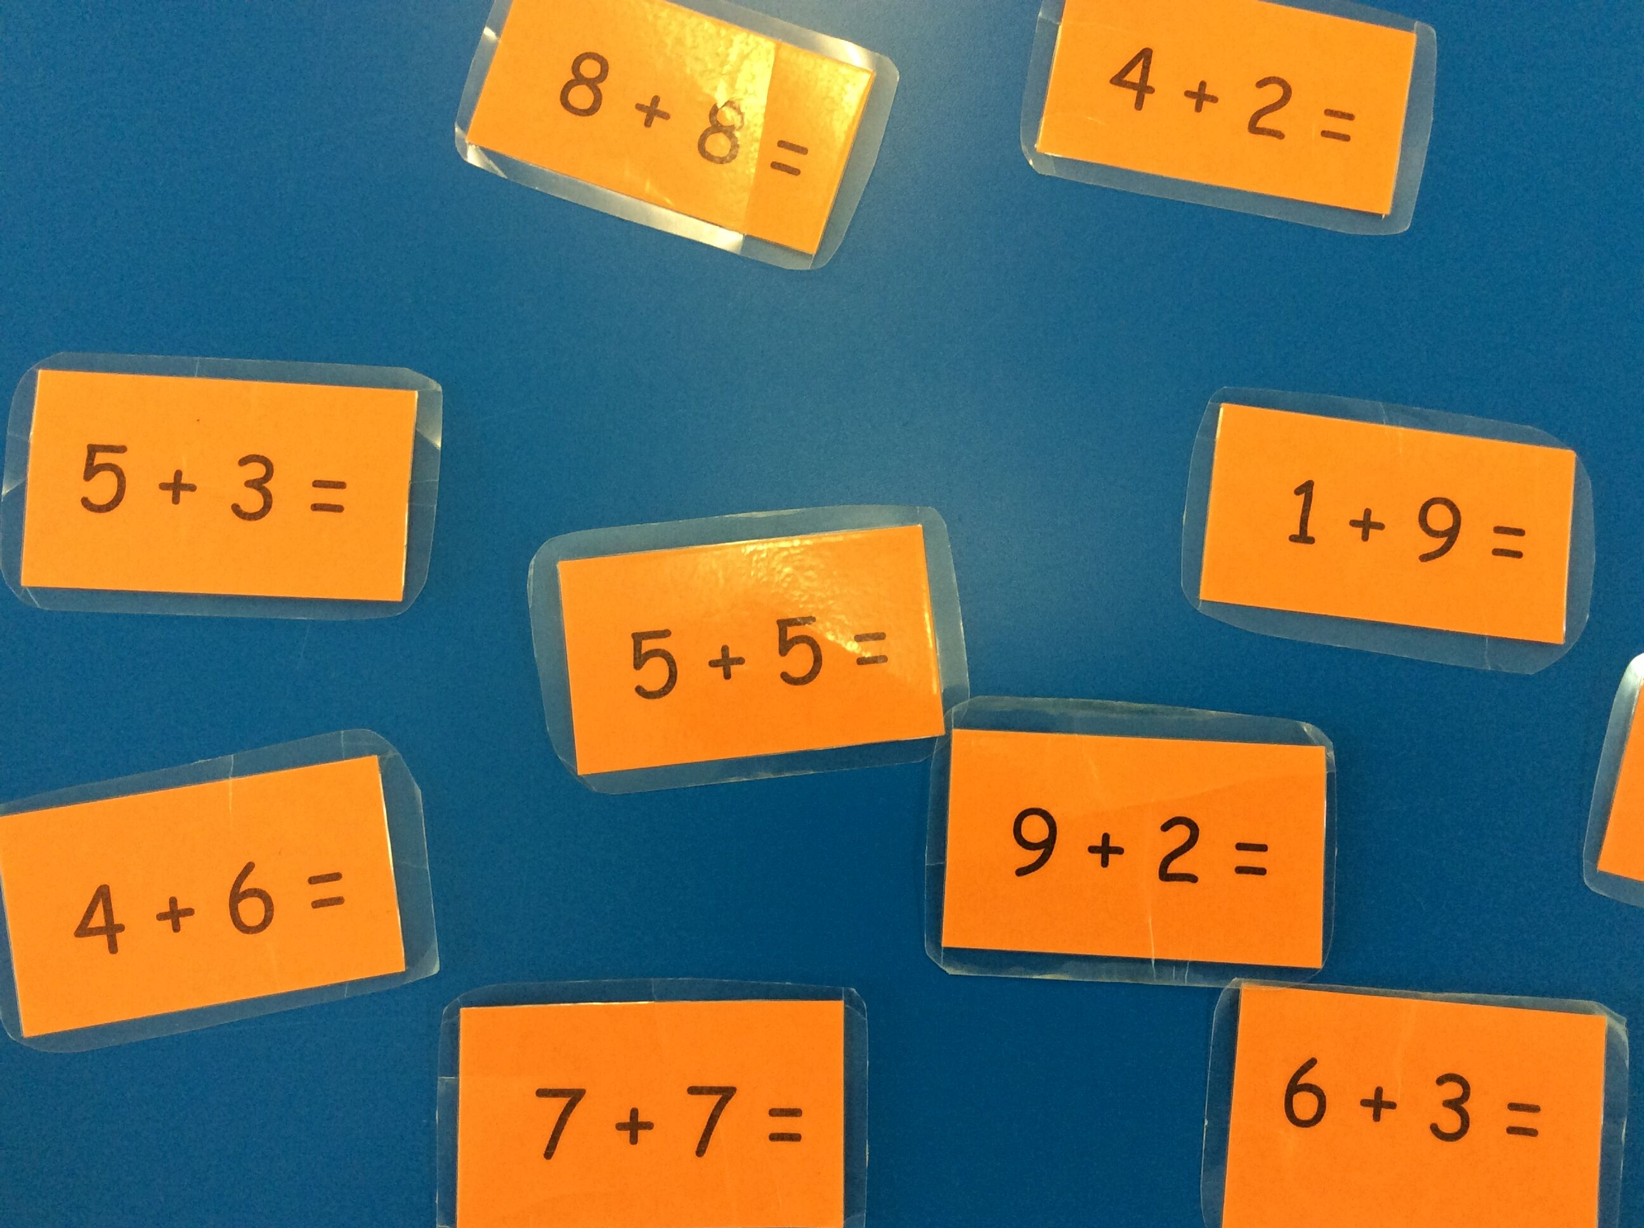
Learn its: number bonds (additions and subtractions)

Slide 22
This term :
Science: Living things and their habitats
Geography: Physical and Human features; Would you prefer to live in a hot or cold place?
History: How was school different in the past?
Computing: Systems and networks, programming
Online safety
Art: Drawing
DT: Structures
Music: Future Yard Music
PE: Rule Making & sending and receiving games

Slide 23
Other information for Year 2
The Behaviour system, our rules and expectations
NPS Values
Rules
Shining Star
Class Reward
Individual Reward

Slide 24
Other information for Year 2
Please bring a coat and a water bottle every day.
PE kit – please wear PE kit on Mondays and Fridays.
Please ensure all items of clothing are named.
Your child’s well-being is of utmost importance to me. Please use the email address oak@nestonpri.cheshire.sch.uk if you have any queries or questions and we will endeavour to respond asap.

Slide 25
Thank you for attending today!
And thank you for your continued support in helping your children.

